Slide 1
Best practices for hydro meteorological network design, revision and improvement of existing infrastructures
Emilio Muñoz, 35-37
28037 Madrid · Spain
T. +34 91 594 95 00
F. +34 91 446 55 46
E-mail: eptisa@eptisa.com
www.eptisa.com

Slide 2


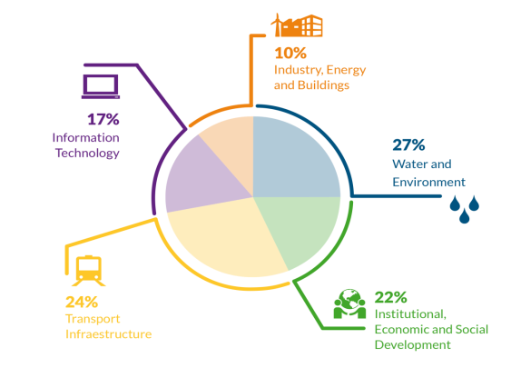


Organization and Main Figures
We are a global company specialised in engineering, consultancy, information technologies and institutional, economic and social development with over 55 years of experience.
The quality of our services has led us to become a reference in the sectors of Transport, Water, Environment, Industry, Energy, Buildings, and Institutional, Economic and Social Development.
120
million Euros
of gross income
in 2014
2000
professionals, of which 1250 are developing their activity outside Spain
+40
countries with ongoing projects
176
million Euros of project portfolio backlog
We apply the technical know-how, innovation and our project management capacity for the benefit of the client and the sustainable development of the society.

Slide 3
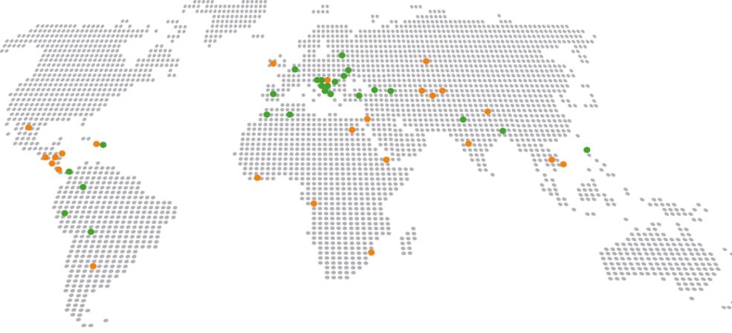
Organization and Main Figures
With a presence in over 40 countries and a network of 25 well established local offices, Eptisa is a global company that acts locally, close to the client and the civil society in which we intervene.
Eptisa Branches / Delegations
Ongoing projects

Slide 4
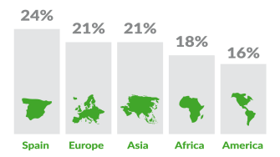
Organization and Main Figures
The local adaptation and the quality of our services are the key elements of our strategy, allowing to grow and expand the scope of our projects in response to the evolution of our clients’ needs.
Europe
Albania
Belarus
Bosnia and Herzegovina
Bulgaria
Croatia
Fyrom
Greece
Ireland
Italy
Kosovo
Montenegro
Moldova
Portugal
Romania
Serbia
Spain
Turkey
Ukraine
United Kingdom
Asia, Caucasus & Middle East
South Asia
Bangladesh
India
Nepal
Central Asia
Kazakhstan
Kyrgyzstan
Tajikistan
Uzbekistan
East & South-East Asia
China
Laos
Philippines
Vietnam
Caucasus
Armenia
Azerbaijan
Georgia
Middle East
Jordan
Palestine
Qatar
Syria
Africa
Angola
Algeria
Congo
Djibouti
Egypt
Equatorial Guinea
Mauritania
Morocco
Mozambique
Namibia
Senegal
South Africa
Sudan
Tunisia
America
Argentina
Bolivia
Brazil
Canada
Colombia
Costa Rica
Chile
Dominican Republic
Ecuador
El Salvador
Guatemala
Haiti
Honduras
Nicaragua
Mexico
Panama
Peru
Uruguay
USA
Venezuela
Geographic distribution
Experience / Ongoing projects

Slide 5
Best practices for hydro meteorological network design, revision and improvement of existing infrastructures
AUTOMATED HIDROLOGICAL INFORMATION SYSTEM CONCEPT
HYDRO METEOROLOGICAL NETWORK DESIGN
STUDY CASE
CONCLUSIONS
Integrated Water Data Management . Case study of HAIS Guadiana River
DATA SERVER, DATA PROCESSING & DATA USES
CONCLUSIONS

Slide 6
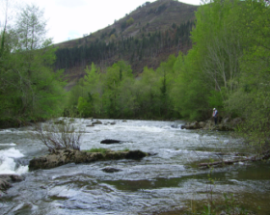
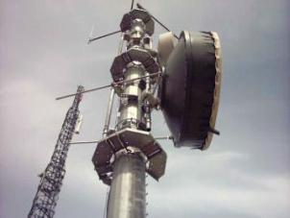
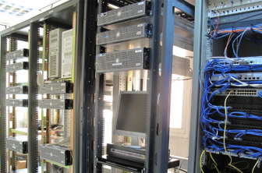
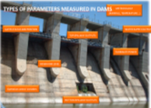


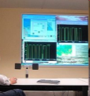
AUTOMATED HIDROLOGICAL INFORMATION SYSTEM (AHIS) CONCEPT
CONTROL POINTS
COMMUNICATION SYSTEM
COMMUNICATION CENTER

Slide 7
AHIS DESIGN IMPLEMENTATION AND OPERATION - PROJECT PHASES
Preliminary Studies
  Collection of Basin Information
  Geographical Data Study
  Needs Detection and Investigation
  Preliminary Budget Estimation
Project
Drafting
  Mapping
  Optimal Network Design / Determine Optimal Cross Sections
  Topography and Bathymetry
  Stations Design / Systems Design
System Deployment
  Works Planning and Detail Engineering
  Installation and Commissioning
  Hydrologic/Hydraulic Calibrations
  Control Center Deployment (Hardware, SCADA, Database and GIS SW)
Operation and Maintenance
  System Monitoring and Operation
  Preventive and Corrective Maintenance
  Ensure Data Quality / Continuous Calibration
  Customer Help

Slide 8
Best practices for hydro meteorological network design, revision and improvement of existing infrastructures
AUTOMATED HIDROLOGICAL INFORMATION SYSTEM CONCEPT
HYDRO METEOROLOGICAL NETWORK DESIGN
STUDY CASE
CONCLUSIONS

Slide 9
QUESTIONS TO ADDRESS WHEN PLANNING HAIS PROJECTS
What need to be set out in each monitoring OBJECTIVES?
METRICS measured to access indicators of water bodies status
PERIODS and FREQUENCY of measurements
IRRIGATION PLANS
DROUGHT MANAGEMENT PLANS
FLOOD MANAGEMENT PLANS
RIVER RESTORATION PLANS
Addressing such questions is critical to ensure a robust solution and proper project planning and execution
Preliminary Studies
  Collection of Basin Information
  Geographical Data Study
  Needs Detection and Investigation
  Preliminary Budget Estimation

Slide 10
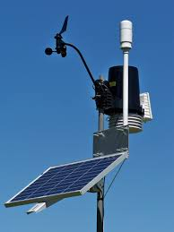
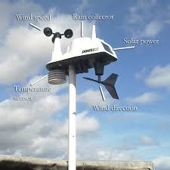
REVISION, IMPROVEMENT AND EXPANSION OF EXISTING INFRASTRUCTURES
To ensure the application of best practices during design, Control points (Automated Weather Stations and Automated Hydraulic Stations) must combine:
Their hydro-meteorological consistency regarding the characteristics of the basin;
Ease of road access;
Possibility of be powered by energy (power line or solar panels + batteries);
Avoid shaded area for communications;
WMO standards must be respected in its location;

Slide 11

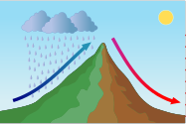
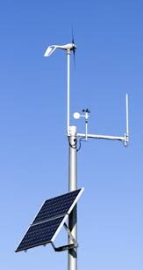
REVISION, IMPROVEMENT AND EXPANSION OF EXISTING INFRASTRUCTURES
Weather stations
Depending on where a weather station is located (precipitation, temperature, wind, etc.) we may use or not the data for the hydrological study of a nearby basin.
It is very useful to have stations in:
The catchments limits and top of the mountains, but must be taken into account Fohen (Föhn) effect areas;
At medium altitude in the mountains;
In the valleys;
This will permit to the hydrologists, as well as having measurements of P, T, wind, etc., to have a better knowledge of distribution of these variables in function of the altitude.
In addition, if possible new stations of the network must be located so that complement other operating networks of the same type, in order to optimize costs and have the fullest possible data records.

Slide 12
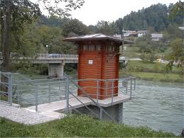
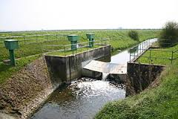

REVISION, IMPROVEMENT AND EXPANSION OF EXISTING INFRASTRUCTURES
Gauging stations
Gauging stations (water level is measured, and flow is calculated in the office using calibration curves) must be distributed throughout the basin with hydrological sense, both headwaters and middle and lower reaches.
In addition it should be studied in detail where you place the stations (characteristics of the stretch of the river) and what type of civil work should be done to place the sensors.
Taking advantage of the civil work, analyze whether to install other sensors on the same site to save costs (Water level, pH and other chemical parameters of the water, and also P and T).
Gauging stations must be installed on straight stretches of river and parallel margins, avoiding areas of pools and whirlpools.
In narrow rivers accuracy is increased channeling the section but maintaining its environmental characteristics.
The type of station may be fixed or variable section, in V-flat, etc.
In wide rivers with large water level variation and a lot of sediments may be adequate install the sensor hanging from a bridge.

Slide 13
Best practices for hydro meteorological network design, revision and improvement of existing infrastructures
AUTOMATED HIDROLOGICAL INFORMATION SYSTEM CONCEPT
HYDRO METEOROLOGICAL NETWORK DESIGN
STUDY CASE
CONCLUSIONS

Slide 14
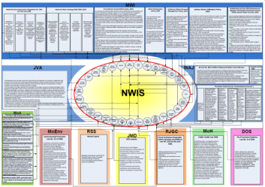
DEVELOPMENT OF A NATIONAL WATER INFORMATION SYSTEM (NWIS)
Client: Ministry of Planning and International Cooperation / Ministry of Water & Irrigation (MoWI)/ Date: 2015 – 2017 / Amount: €1,499,725
The project aims to deliver a completely new functional Water Information System (WIS) that can be consulted using a username and a password by all stakeholders. Data from the old WIS will be migrated to the new WIS and data feeding from other systems in MoWI will be established. At the same time the Information System of other stakeholders will be assessed and support will be given to improve capacity. 2 components:
Component 1 which includes all necessary assessments and preliminary designs of the new WIS within MoWI and basis of the NWIS for stakeholder’s discussion and approval prepared.
Component 2 to provide for the development of the WIS within MoWI, the upgrading of other stakeholders information systems, and the functional design of the NWIS.

Slide 15
Services provided:
Component 1
Identify the overall requirements of the MWIS in terms of key sector indicators, functionalities and reports supporting the decisions making processes
Develop a proposal of Guidelines about decision-making procedures of the PSC
Develop a plan for Target groups Capacity Building and Knowledge Transfer activities
Performing a gap analysis to clearly define the scope of requirements of the expected re-engineered WIS in conformity with the NWIS requirements
Assessment of WIS (functions and data) and all other related systems within MoWI
Assessment of Information systems in other stakeholders' institutions and identify the needs
Assess the IT infrastructure and identify the needs in terms of hardware/software components
Assessment of needs in terms of staff training and capacity building
Component 2
Development, Installation, testing and commissioning of the re-engineered WIS within MoWI
Upgrading of Information Systems of other stakeholders' institutions
Development of a comprehensive functional design of the NWIS
Support the Data Migration activities as per final approved Plan
Support the CA in the procurement of hardware and software components
Delivery of the training.
Prepare a draft plan for the Programme Phase II

Slide 16
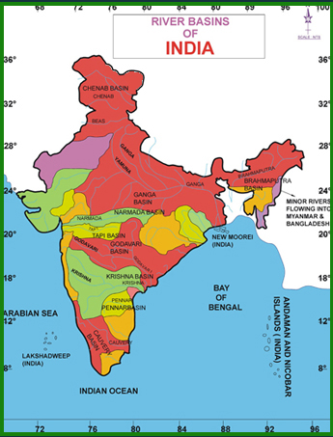
PROCUREMENT FOR SUPPLY, INSTALLATION AND COMMISSIONING OF SURFACE WATER INFORMATION SYSTEM (eSWIS)
Client: River Data Directorate, Central Water Commission, Ministry of Water Resources/ Date: 2012-2013 / Amount: 467,732€
The procurement is focused on using open source software, replacing the underlying database system that the Central Water Commission is using for central storage of hydro-meteorological data, replacing the existing system for validation and data processing, moving data entry from stand alone systems to a web environment, and providing the web services required for data dissemination that, among other tasks, allow the support of the Flood Warning functions.
Scope: The new system, e-SWIS (web and GIS Surface Water Information System) will be implemented in participating Agencies in Hydrology Project II, and potentially in all States and UTs of India.

Slide 17
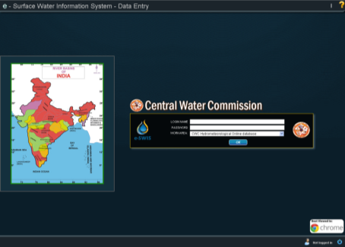
Services provided:
Review of the existing Databases, System Design, and Processes
System design for data-flow, storage, dissemination, web platforms and GIS components and processes.
Development and implementation of the software using open source software in a phased manner.
Migration of the existing data from HIS databases (i.e. SWDES/WISDOM/HYMOS)
Training to different section of staff (i.e. end users, administrators, etc.)
Documentation, online help, real-time help.
Warranty (three years) and maintenance (seven years) for the next ten years

Slide 18
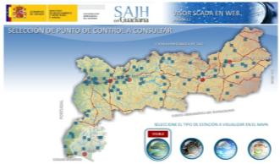
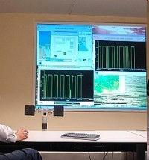
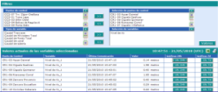
Implementation of a Automatic Hydrological Information System on the Guadiana River Basin and its subsequent maintenance, conservation and operation, Spain
Client: Ministry of Environment and Rural and Marine Affairs / Date: 1999 – 2012 / Amount: € 11,917,940
The objective of the project was the design, installation of water resources control network and basic infrastructure for the Automatic Hydrologic Information System (SAIH) on the Guadiana River Basin, Spain. This involved a collaboration with the Guadiana Hydrographical Confederation for the provision of consultancy services and technical supervision for the installation of network checkpoints in the river basin.
Provide maintenance, conservation and operation services of the Automatic Hydrologic Information System (SAIH) on the Guadiana River Basin.
Applied technologies: Applied technologies: GIS, Arc /View; Access database; Excel; Mathematical models for Hydrological and Hydraulic Management

Slide 19
Main services provided:
Technical supervision for the design and installation of the Automatic Hydrologic Information System Identification of the adequate Automatic Hydrologic Information System
Basic infrastructure for the Automatic Hydrologic Information System
Technical studies for installation support
Control and monitoring of the installation
Installation of network checkpoints in the river basin
Mathematical models for hydrological and hydraulic management
GIS, Arc/View application AWIS operation
Technical data:
Basin surface: 60.361 Km^{2;} Population: 1.681.235 inhabitants ; Annual medium flow: 6.168 Hm³ •

Slide 20
Best practices for hydro meteorological network design, revision and improvement of existing infrastructures
AUTOMATED HIDROLOGICAL INFORMATION SYSTEM CONCEPT
HYDRO METEOROLOGICAL NETWORK DESIGN
STUDY CASE
CONCLUSIONS

Slide 21
CONCLUSIONS
In designing a good Hydro Meteorological Network , because of its many uses as well as high cost of installation and maintenance, it is necessary the intervention of multidisciplinary teams, specialized in various areas of knowledge, that are usually provided by major engineering companies.
A good Hydro Meteorological Network design allows Water Authorities to know the current hydro meteorological situation, in river basins, in order to :
Water resources management optimization
Forecast and control of floods
Hydrological and hydrometeorological database’ improvement
Aquifers’ assessment
Water quality data control
Dam safety

Slide 22
Best practices for hydro meteorological network design, revision and improvement of existing infrastructures
Emilio Muñoz, 35-37
28037 Madrid · Spain
T. +34 91 594 95 00
F. +34 91 446 55 46
E-mail: eptisa@eptisa.com
www.eptisa.com
THANK YOU !
Luis Frauca
lfrauca@eptisa.com

